Slide 1
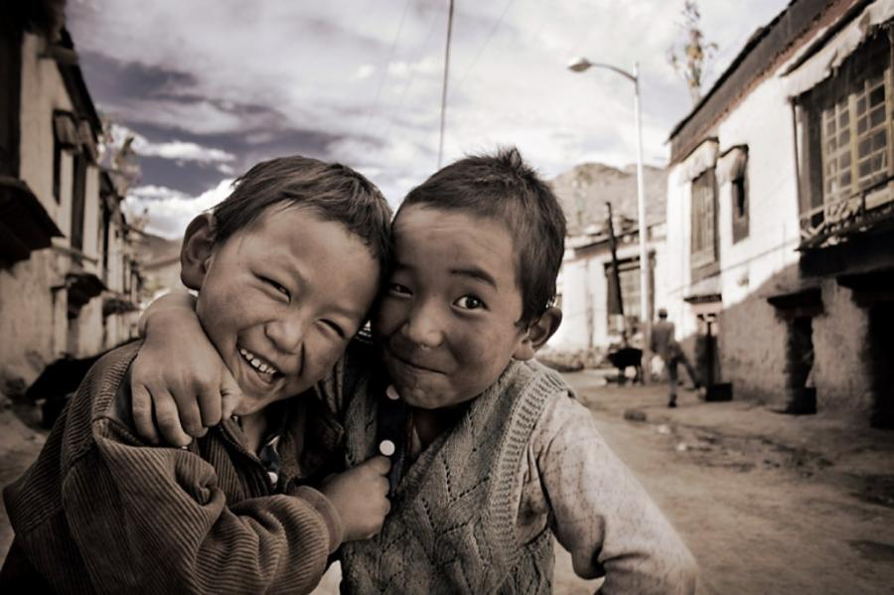
Medi Serve
Objective
The objective of our team is to provide generic medicines after reducing its cost to those who are unable to afford these high price medicines because there is right of every INDIAN to be healthy . So we decided to add these generic stores to our web page.

Slide 2
Title
we are united creation and our title of web page is Medi-Serve means to serve our medical facilities to the people below poverty line because it is the right of every Indian to be healthy and safe

Slide 3
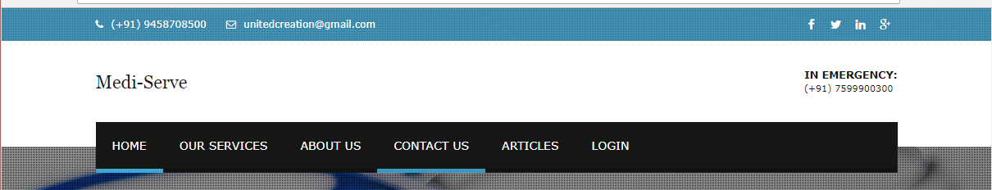
Navigation bar
The navigation bar contains all the information of page
Home
Our services
About us
Contact us
Articles
Login

Slide 4
HEADER
Header of our page contains
Buy medicines – to purchase medicines
Customercorner- for emergency services, healthy tips, donation
Medical services and resources
Who we are – to reach us
Disease outbreaks- current diseases and their precaution and cure
Contact us
Join us

Slide 5
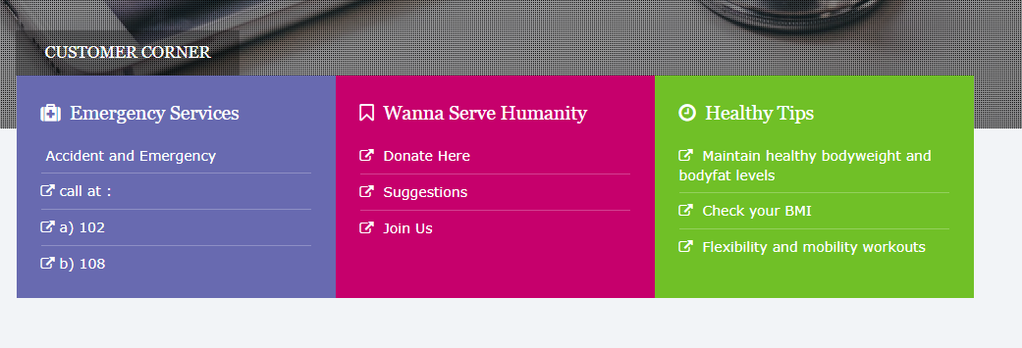
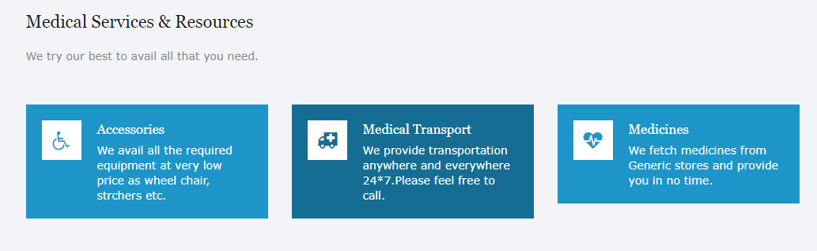
screenshots

Slide 6
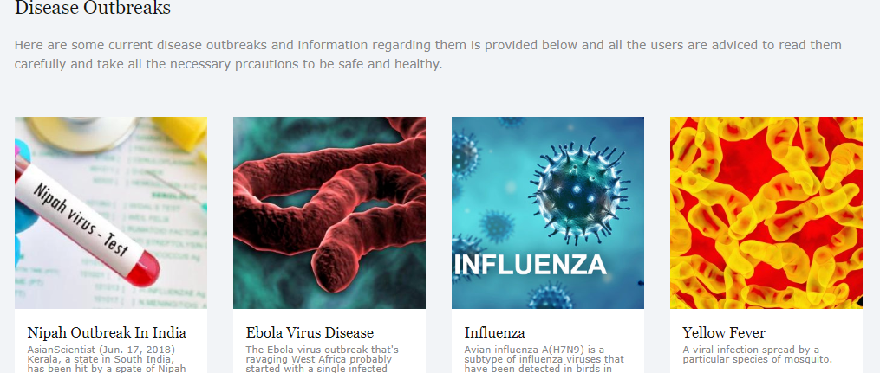
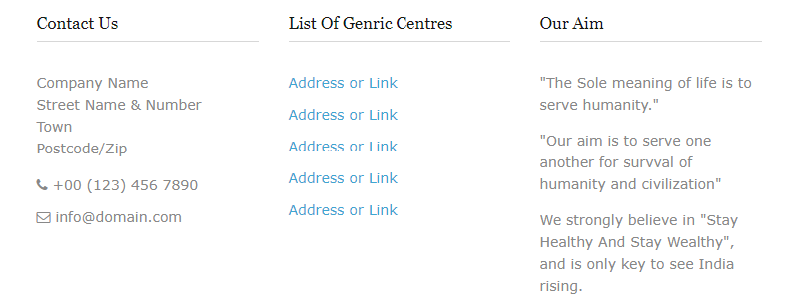

Slide 7
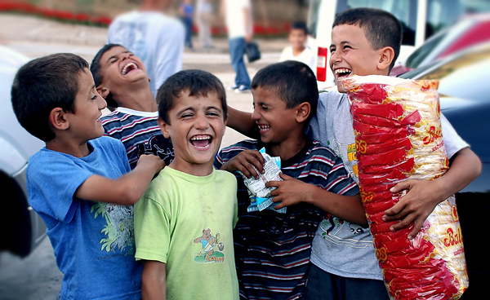
footer
Lastly we have footer with copyrights and yah!! We have created it with love... To be the reason behind millions of smiles....

Slide 8
Our Goal
And lastly we want to say that we will work on this project till we will accomplish all our objectives......

